Slide 1


Extension Development
Sunil Kumar

Slide 2

Index
What is a add-on?
Things you can do with Add-Ons
Installation – Add-On SDK
Architecture/Control Flow
Communication using Ports
Initializing & Folder structure
High Level API Introduction
Submission of add-on to AMO
Spann Jira demo

Slide 3

What is a Firefox add-on ?
Add-ons are small pieces of software that add new features or functionality to your installation of Firefox.
Add-ons can augment Firefox with new features, foreign language dictionaries, or change its visual appearance.

Slide 4
Types of Firefox add-ons?
Extensions - add new features to Firefox
Light weight Themes
Complete Themes
Search Providers
Dictionaries & Language packs
Plugins - help Firefox display or understand different types of media

Slide 5
Things you can do with add-ons
Access clipboard
Menus & Context-menu
Notifications
Get access to any page’s DOM
Passwords
Requests
Storage System
Tabs
Widget
… much more

Slide 6
Installation
Requirement – Python 2.6 or 2.7
Download & extract Add-On SDK : https://ftp.mozilla.org/pub/mozilla.org/labs/jetpack/jetpack-sdk-latest.zip
Modify activate.bat : http://stackoverflow.com/a/23003887/819866
> cd /path/to/addon/sdk/bin
> activate
https://developer.mozilla.org/en-US/Add-ons/SDK/Tutorials/Installation

Slide 7
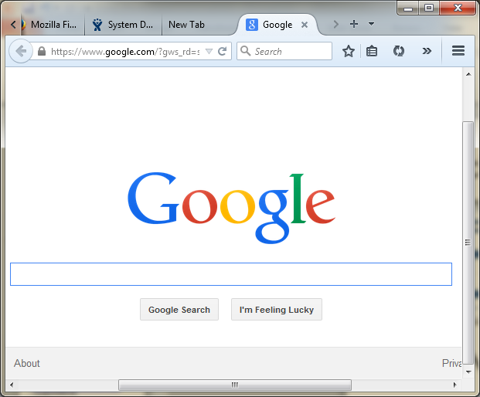
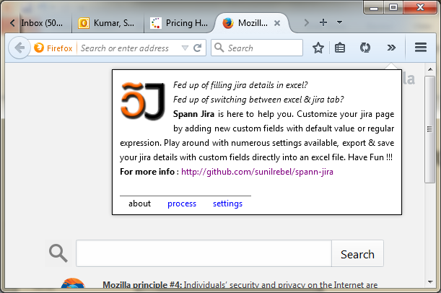
Architecture/Control Flow
Communication using Ports
Communication using Ports
Add-On Process (main.js)
Listener/tabs
Panel

Slide 8
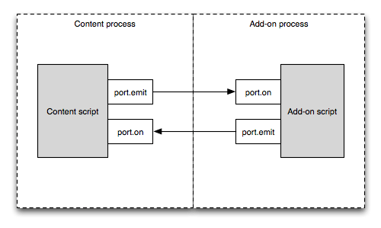
Communicating using “port”
https://developer.mozilla.org/en-US/Add-ons/SDK/Guides/Content_Scripts/using_port

Slide 9
Initializing an add-on
C:\sunil\softwares\addon-sdk-1.17\bin>activate
Welcome to the Add-on SDK. For the docs, visit https://addons.mozilla.org/en-US/developers/docs/sdk/latest/
(C:\sunil\softwares\addon-sdk-1.17) C:\sunil\softwares\addon-sdk-1.17\bin>cd c:\sunil\my-addon
(C:\sunil\softwares\addon-sdk-1.17) C:\sunil\my-addon>cfx init
* lib directory created
* data directory created
* test directory created
* generated jID automatically: jid1-KoMESYDkSRAgiw
* package.json written
* test/test-main.js written
* lib/main.js written
Your sample add-on is now ready.
Do "cfx test" to test it and "cfx run" to try it. Have fun!
(C:\sunil\softwares\addon-sdk-1.17) C:\sunil\my-addon>

Slide 10
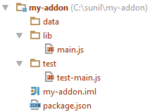
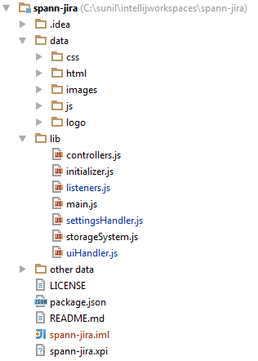
Folder structure

Slide 11
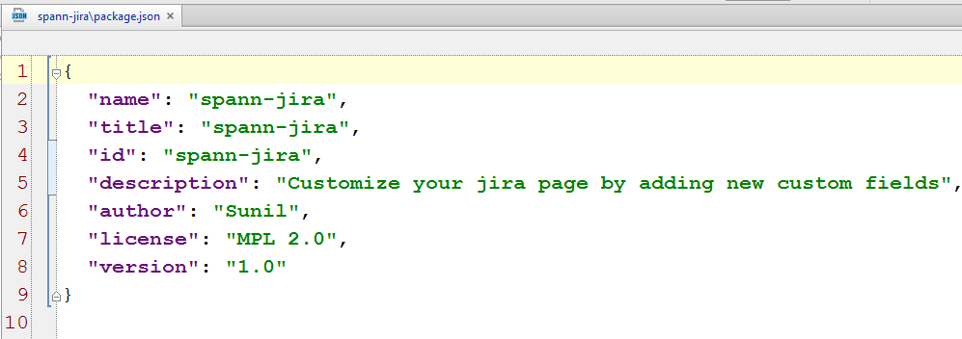
package.json

Slide 12
High Level API – Introduced
Notifications
Self & Panel
Context – menu
Hotkeys
Selection
Panel
Page-mod (listener)
Simple-storage
Tabs
… more at https://developer.mozilla.org/en-US/docs/Firefox_addons_developer_guide

Slide 13
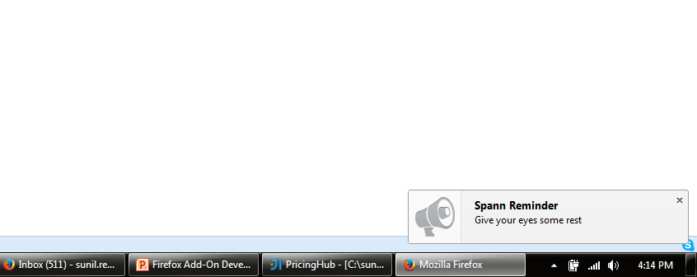
Notification

Slide 14
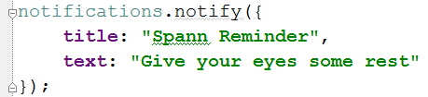
Notifications

Slide 15
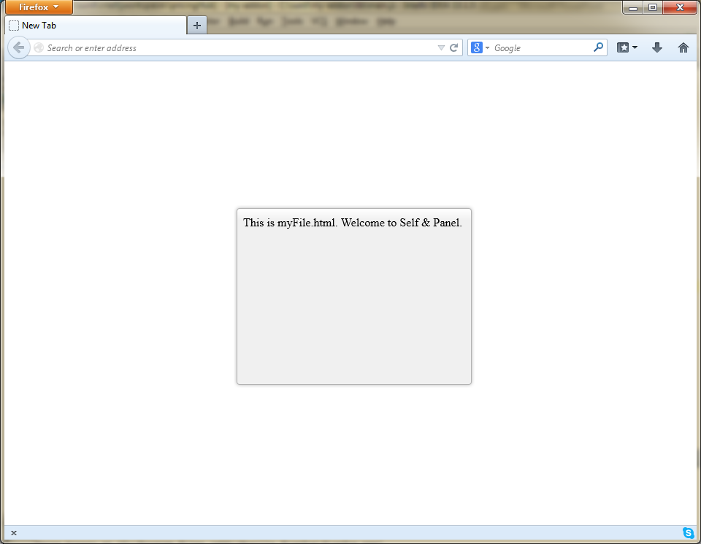
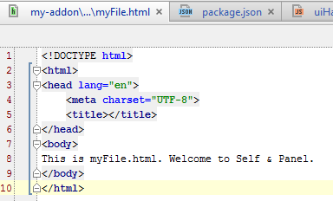
Self & Panel

Slide 16
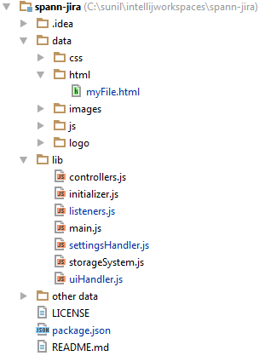
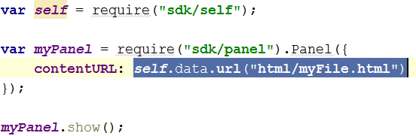
Self & Panel

Slide 17
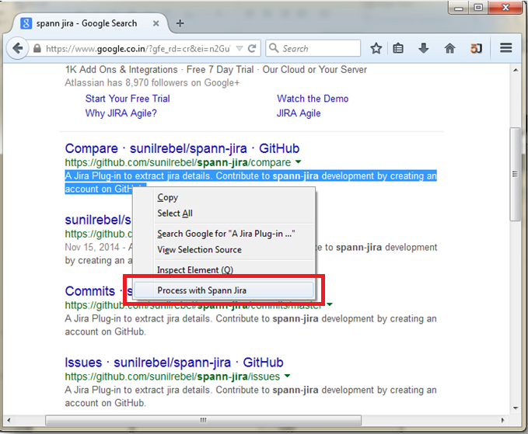
Context-Menu

Slide 18
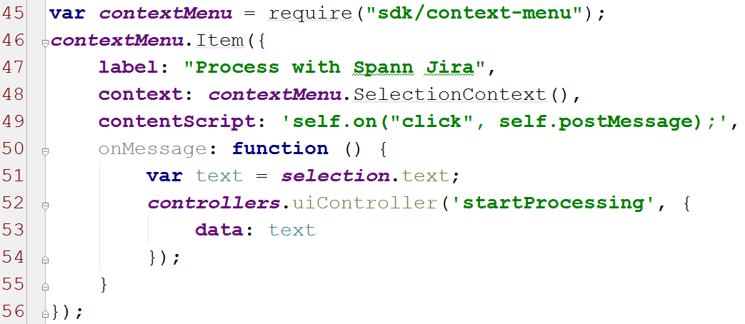
Context – Menu

Slide 19
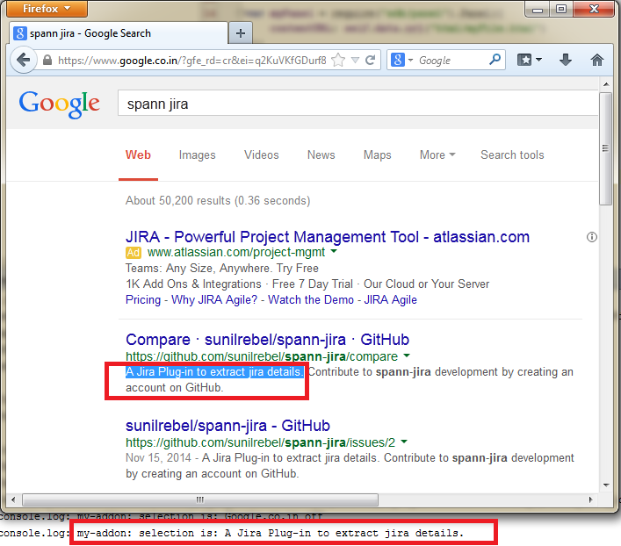
Selection

Slide 20
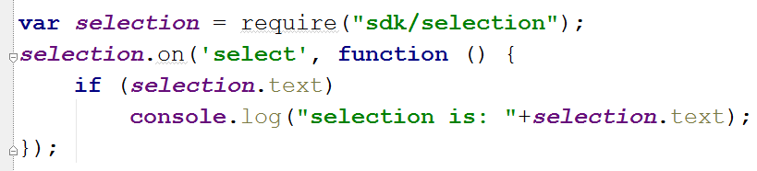
Selection

Slide 21
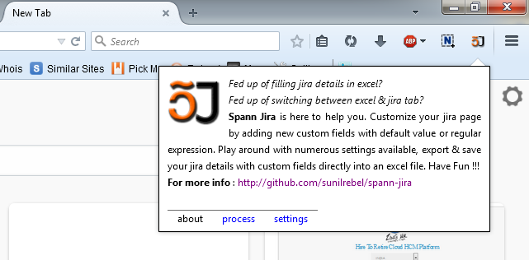
Panel

Slide 22
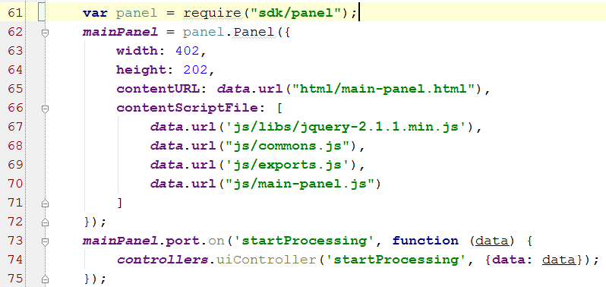
Panel

Slide 23
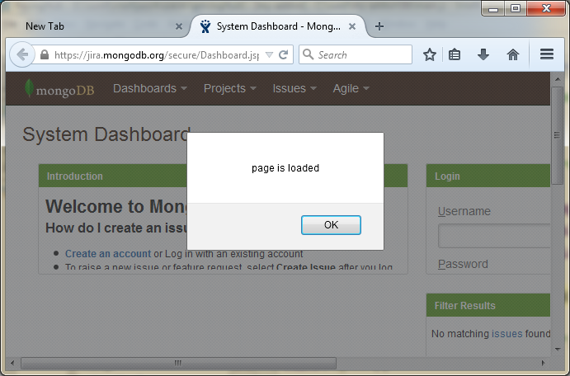
tabs

Slide 24
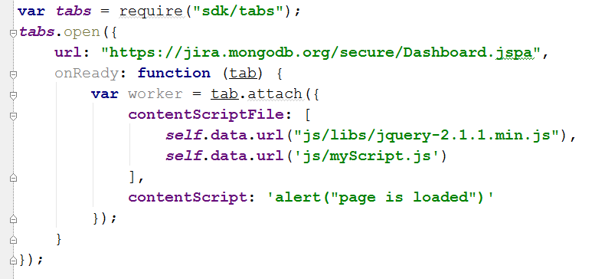
tabs

Slide 25
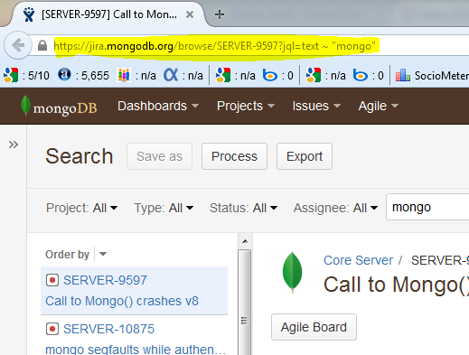
Page-Mod (listener)
https://jira.mongodb.org/browse/SERVER-9597?jql=text ~ “mongo”

Slide 26
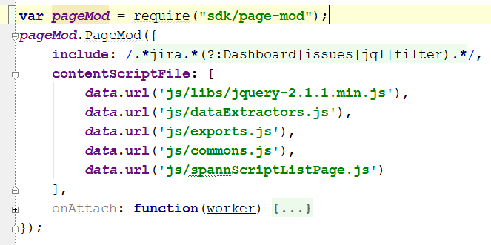
Page-Mod (listener)

Slide 27
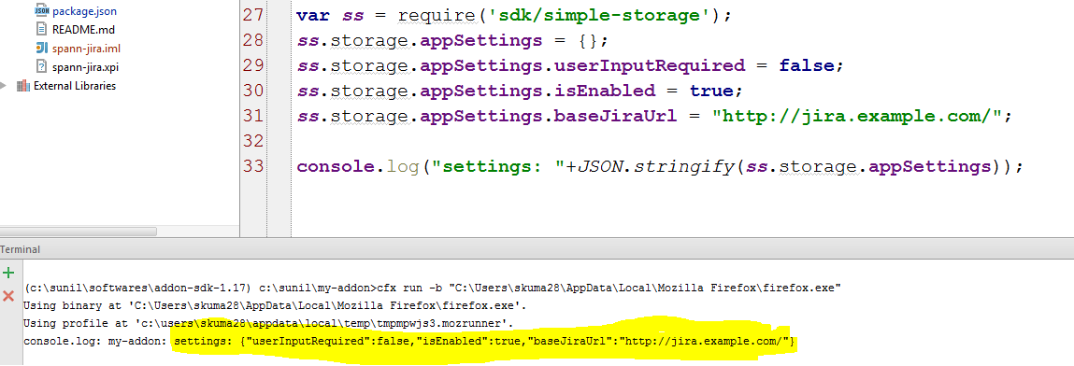
Simple-storage

Slide 28
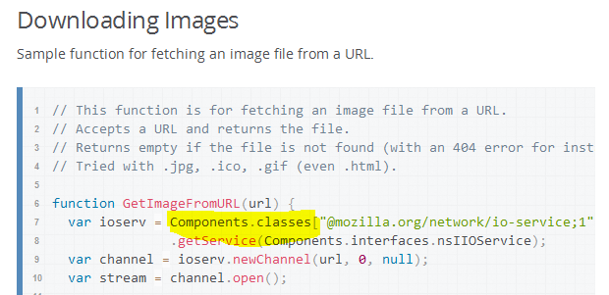

Note:
http://stackoverflow.com/a/13640834/819866

Slide 29
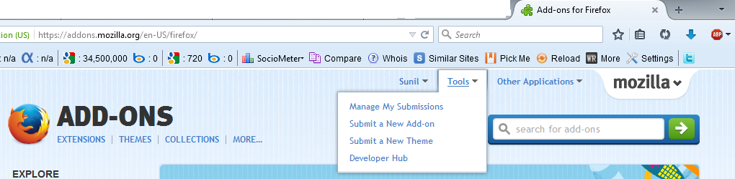
Submission of add-on to AMO (addons.mozilla.org)
https://addons.mozilla.org/en-US/developers/addon/submit/1
> cfx xpi
Browse the xpi file > provide add-on description.
Choose between quick review & full review (recommended)

Slide 30
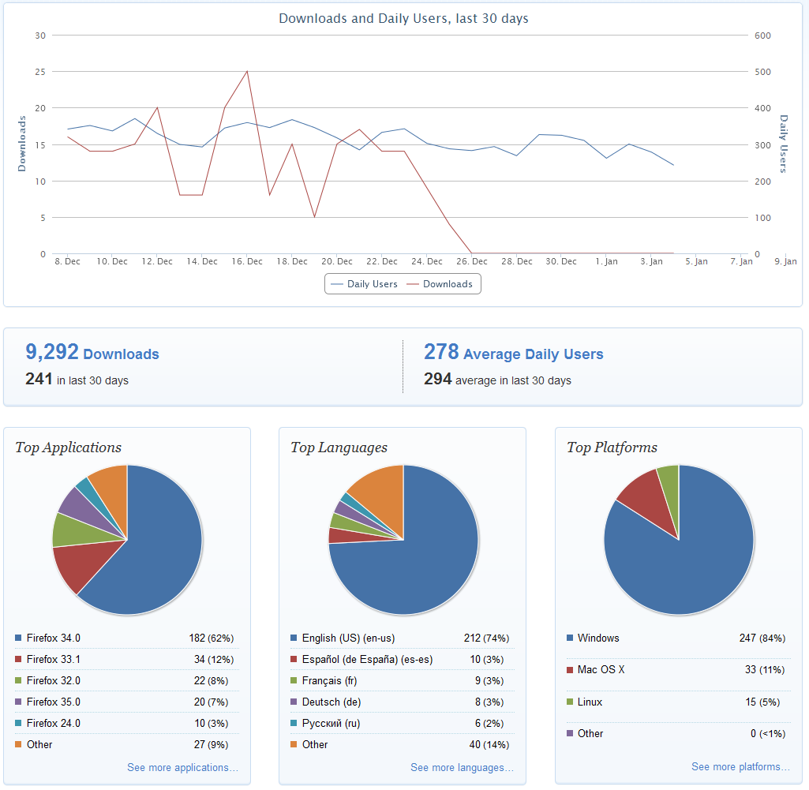
Statistics

Slide 31
Spann Jira Demo

Slide 32
Thanks
Hope you’ve enjoyed the session (:

